Slide 1
Impacts of Antifouling paint on Hemigrapsus oregonensis and their stress physiology response
By Cali Weber, Amit Klier, Elise Stallwood, and Sebastian Gemberling

Slide 2
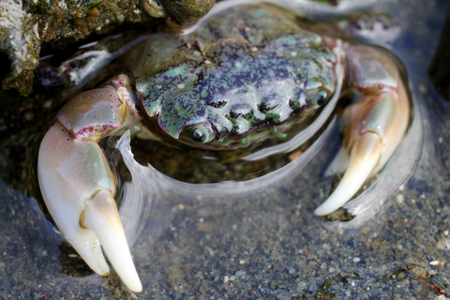
Table of Contents
01
02
03
04
Background
Research Question
Hypothesis
Experimental Design

Slide 3
01
Background

Slide 4
Antifouling Paint
01
H. oregonensis
03
Prevents microorganisms from attaching to surfaces
Contains heavy metals ( Cu, Pb, Zn)
Hairy shore crab
Model organism
Native species in the puget sound
Impacts of Trace Metals
02
Biofouling
04
Accumulation of microorganisms, plants, algae, and small animals on unwanted surfaces (boats, buoys, markers)
Copper and zinc concentrations disrupt ion regulation, impair growth and reproduction in marine organisms

Slide 5
02
How does antifouling paint impact crab ecophysiology?

Slide 6
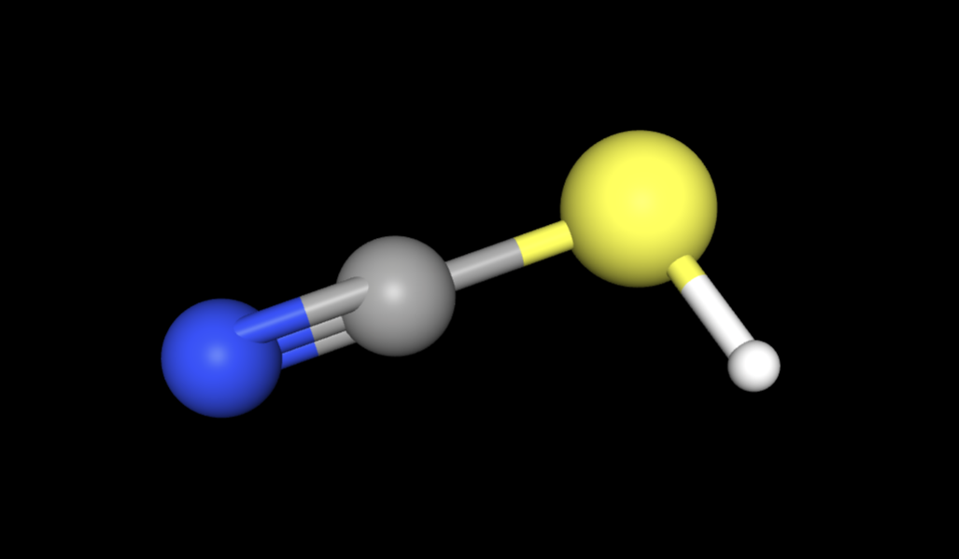
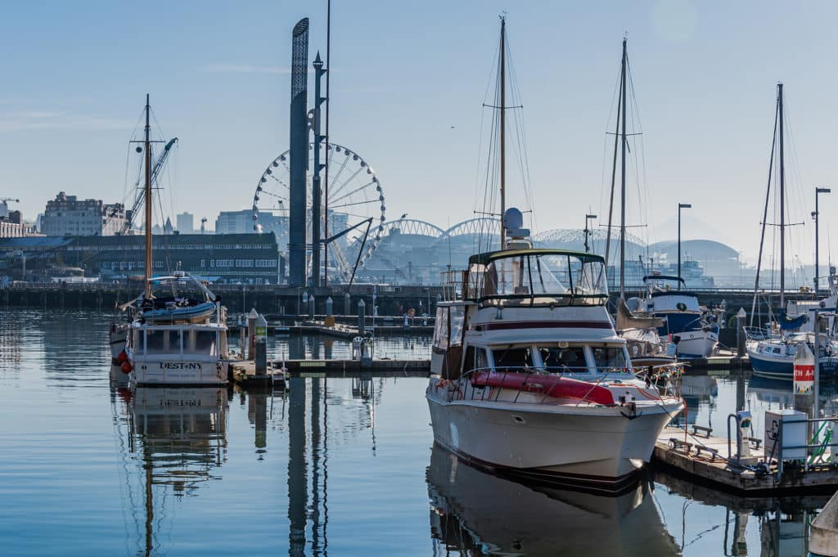
The Chemistry
National Center for Biotechnology Information (2025). PubChem Compound Summary for CID 11029823, Copper(1+);thiocyanate. Retrieved April 14, 2025 from https://pubchem.ncbi.nlm.nih.gov/compound/Copper_I_-thiocyanate.
Notes:
This is the active ingredient in the antifouling paint that we will be using. It is called cuprous thiocyanate. The way the paint works is that when it comes in contact with water, this molecule releases the copper ion into the water. This copper ion is what prevents the barnacles and other organisms from attaching to the underside of the boat. This is not a byproduct of this paint, it is specifically made to leach copper into the water. The paint is ablative which means that it will continue to release copper into the water. This presents an issue with derelict vessels and other infrastructure that are left to sit in the water for years on end. This paint is also used on buoys, mile markers, and any other floating object made out of metal. Because of this, the highest concentrations are typically found at marinas, which are well known to be in areas that are inhabited by invertebrates, such as our hairy shore crab.

Slide 7
Trace Metal Impacts
Trace metals find their way into organisms from absorption through gills and skin, or from consuming sediment
Trace metals over concentration thresholds have been found to impair osmoregulation, growth, and regulation, and in extremely high concentrations, trace metals induce death
Borkow, G., & Gabbay, J. (2005). Copper as a Biocidal Tool. 12(18), 2163–2175.
Cima, F., & Varello, R. (2023). Potential disruptive effects of copper-based antifouling paints on the biodiversity of coastal macrofouling communities. Environmental Science and Pollution Research, 30(4), 8633–8646. https://doi.org/10.1007/s11356-021-17940-2
Notes:
When trace metals like copper, zinc, and lead enter the marine environment, they tend to dissolve after a period of time. When this happens marine species can absorb these trace metals through their gills and skin and from consuming sediment. Although trace metals are important nutrients (as an example copper is used as a cofactor for enzymes involved in respiration and other metabolic processes) when they are over a certain concentration, they can become toxic and can impact growth, regulation, and other processes. In one research study we found, when Artemia brine shrimp were exposed to a 100 mm2 surface panel covered with antifouling paint in 8 mL of seawater, there was a reported 90% mortality after 48 hours. In other studies, copper was found to be toxic through oxidative stress. The osmotic and ionic processes cease when copper increases, and this will prevent the organism from maintaining a homeostatic state and increase the amount of stress on the individual. When we think of the size of boats, and buoys, they are covered by much more antifouling paint than the test panel in the Artemia study, indicating that they are likely much more toxic. This leads us to our experimental idea for testing the impacts of antifouling paint on crabs and brings us to our hypothesis -

Slide 8
03
Hypothesis

Slide 9
Null
Alternative
There will be no changes to crab ecophysiology in response to antifouling paint
There will be an increase in the righting time, lactate levels and triglyceride levels with crabs exposed to increasing amounts of antifouling paint.

Slide 10
04
Experimental Design
Notes:
So how will we actually conduct our experiment.

Slide 11
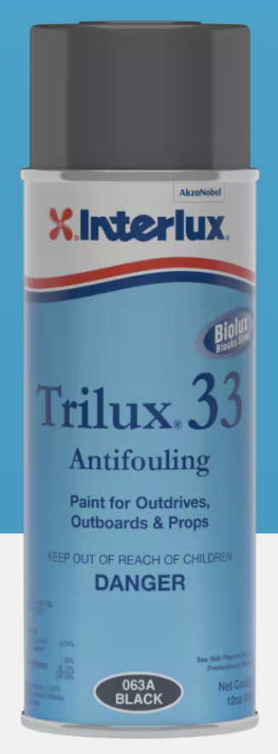
Trilux® 33 Aerosol
Active ingredient: Cuprous Thiocyanate biocide
Chemical Formula: CuSCN
Notes:
So for our experiment, First we needed to decide what paint to use. This is just one that we will have access to and the active ingredient is Cuprous Thiocyanate biocide.

Slide 12
Model Experiment
A simple bioassay with Artemia larvae to determine the acute toxicity of antifouling paints
by Persoone, G. & Castritsi-Catharios, J.
Set the base for toxicity testing of paints that are used on submerged surfaces
Used surface area to volume ratio as metric for how to increase paint concentration
Notes:
Inorder to test this paint we are mimicking a study done on brine shrimp, that set the standard for how to perform toxicity testing of paint.
They found that creating different a surface area to volume ratio of the paint and the water is one of the best ways to control how much paint the organisms are being exposed to.
Measuring how much spray paint is being used can be difficult to get a specific volume, and so by using a surface area to colume ratio we can control the paint amounts.

Slide 13
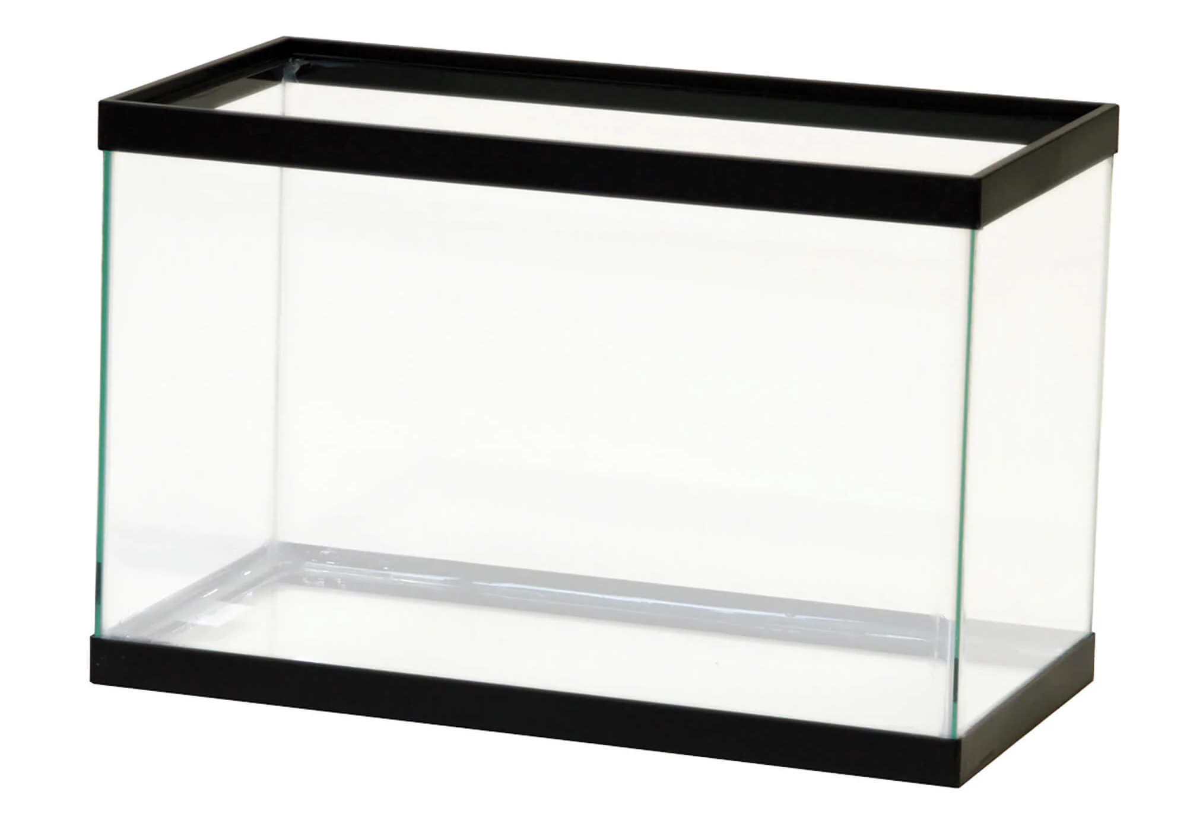
🦀
🦀
🦀
🦀
Control
🦀
🦀
🦀
🦀
🦀
🦀
🦀
🦀
🦀
🦀
🦀
🦀
🦀
🦀
🦀
🦀
🦀
🦀
🦀
🦀
🦀
Surface Area:
4 cm²
9cm²
16cm²
25cm²
= Aluminum Foil Sprayed with antifouling paint
*Crabs left in conditions for one week

Slide 14
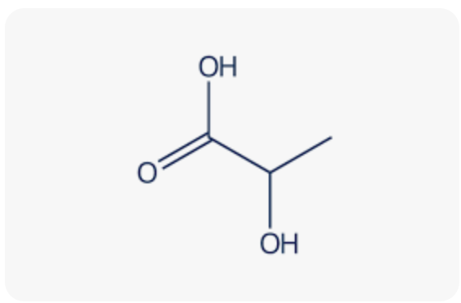
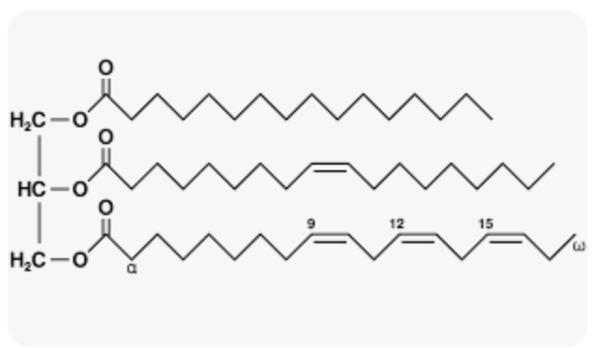
Measured Parameters
Lactate
Righting time
Triglycerides
Lactate is a byproduct in anaerobic respiration
Under stressful conditions the crabs will increase use of anaerobic respiration resulting in the buildup of lactate in the hemolymph
The amount of time it takes for the crab to flip over after being placed on its back
Longer righting times indicate increased stress
A lipid form of energy reserve
Increased stress will result in the increase of triglycerides to get energy
✧ Stress induces the release of crustacean hyperglycemic hormone, increasing lipids within the hemolymph (Lorenzon et al., 2008). ✧

Slide 15
Questions?
Persoone, G., & Castritsi-Catharios, J. (1989). A simple bioassay with Artemia larvae to determine the acute toxicity of antifouling paints. Water Research, 23(7), 893–897. https://doi.org/10.1016/0043-1354(89)90014-6
Lorenzon, S., Giulianini, P. G., Libralato, S., Martinis, M., & Ferrero, E. (2008). Stress effect of two different transport systems on the physiological profiles of the crab Cancer pagurus. Aquaculture, 278(1–4), 156–163.
Borkow, G., & Gabbay, J. (2005). Copper as a Biocidal Tool. 12(18), 2163–2175.
Cima, F., & Varello, R. (2023). Potential disruptive effects of copper-based antifouling paints on the biodiversity of coastal macrofouling communities. Environmental Science and Pollution Research, 30(4), 8633–8646. https://doi.org/10.1007/s11356-021-17940-2
National Center for Biotechnology Information (2025). PubChem Compound Summary for CID 11029823, Copper(1+);thiocyanate. Retrieved April 14, 2025 from https://pubchem.ncbi.nlm.nih.gov/compound/Copper_I_-thiocyanate.

